Slide 1

UWA DATA ANALYSIS BOOTCAMP – PROJECT 3 Data visualization TEAM 5 proposal-2
Our Team
Johan Snyman
Photo and github Links please
Minh Bui
Our Git Repository
https://github.com/JohanfromEsperance/Project-3-DataVisualization.git
SPA.CSV – Reduxo SO inspection data

Slide 2
Project 3-Data visualization Our team will select, analyze, extract, transform, load a dataset and visualize a dashboard and map for SPA state of the asset information: Where are the hotspots for asset conditions on our plant
Data Sources
Review
Inspect
Simulate
E
T
L
V
Exploration and Inspiration
Load
Visualize
Extract
Transform
Locate and download data
SPA- REDUX SAO CSV files
Use JSON and CSV
Prework, structure, common keys, duplicates and NAN
Verify Data formats
Establish MAP and DASHBOARD formats
Design DASHBOARD
LOAD JSON and MAP
Load .CSV to Python and convert
Check CSV loaded correctly
API endpoints
Wrangling steps
Cleaning – NAN
Filter locations/FORMAT
Align location and usage
Rename headers
Remove columns
Save in SQL
Create and display Busy road map
PYTHON
LEAFLET
HTML
JAVA script
SQL
Check and Test Website
Load to PYTHON
Load to WEB
Check and test data

Slide 3
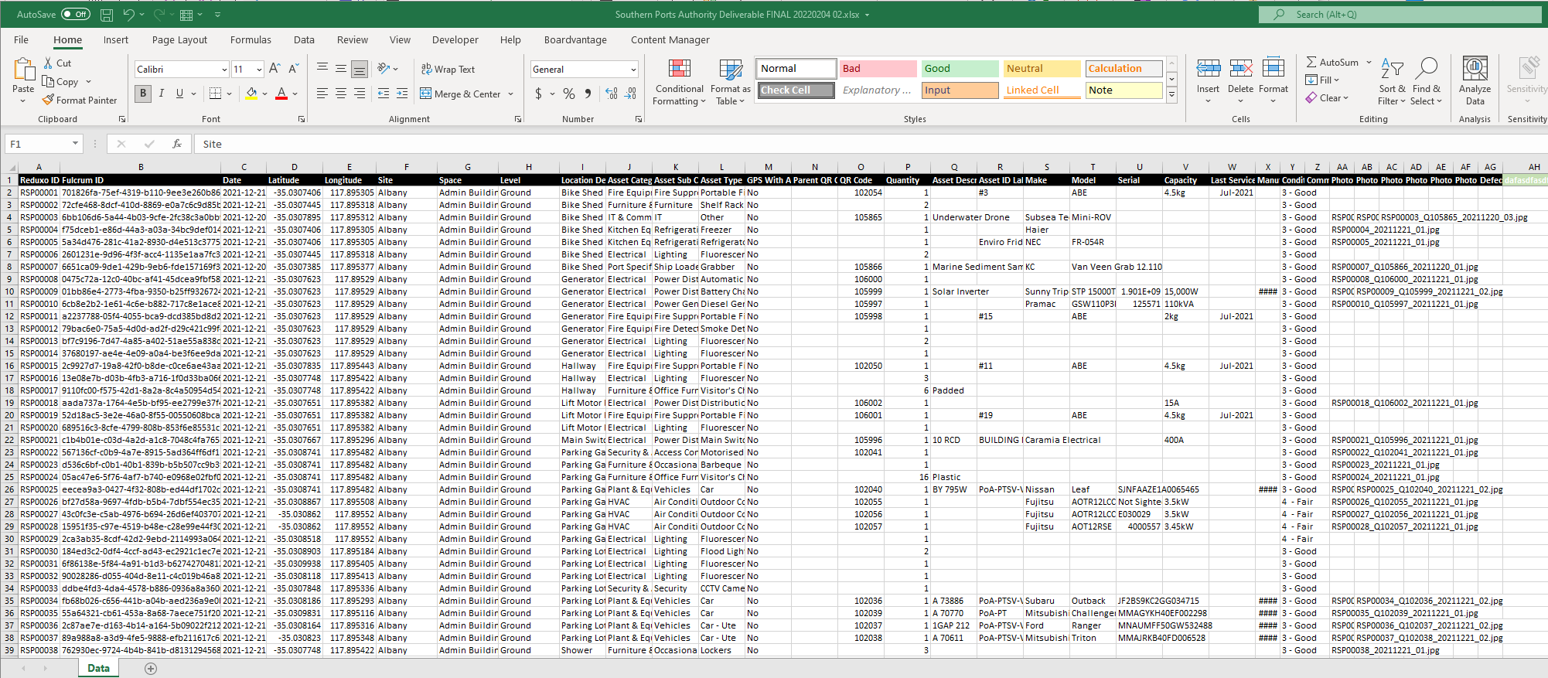
Extract and data sample
Data Sets
Datasets Sourced From – Southernports SAO.CSV
File A – SPA-Zip dataset
Will limit the design to the first 1000 datapoints
Will filter for the top 10 busiest streets/routes
File B - https://data.cityofchicago.org/Transportation/E-Scooter-Trips-2020/3rse-fbp6/dataABS/CSV

Slide 4
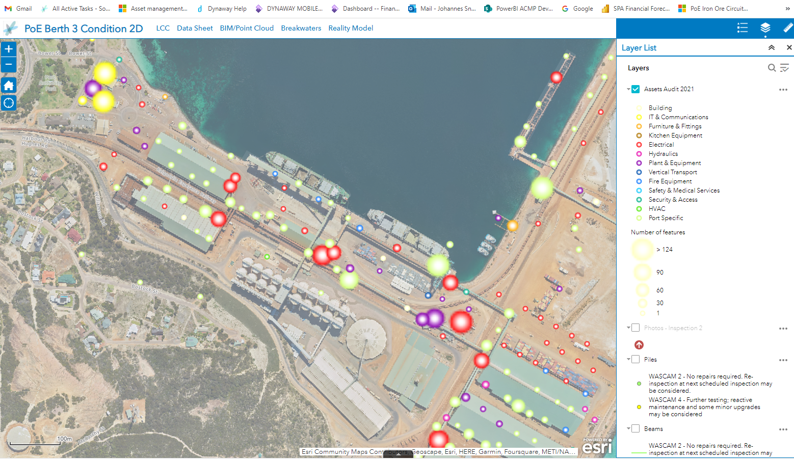
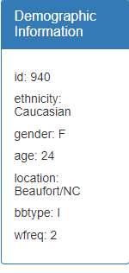
WEB PAGE-Southern Ports State of the Asset
Display via github.io
HEADER
Body/DIV2
Body/DIV10
Demographic data for Top assets
MAP -
Overlay – DATA
OVERLAY Markers
HOVER MARKERS – Current state of the asset

